Slide 1

Face Recognition based Attendance Management
System
Under the Guidance of :-
Mr. Gyanabrata Sahoo
Presented by :-
Bibidh Bhardwaj
Abhijeet Parida
Anshuman Dash

Slide 2
Contents:-
1. Literature Review
2. Introduction
3. Current Attendance Management Challenges
4. Face Recognition Model
5. How Face Recognition Can Help
6. Key Features of Our System
7. Case Studies
8. Implementation and Maintenance
9. Conlusion

Slide 3
Literature Review
SL. NO. | YEAR | NAME OF ALGORITHM | AUTHOR | ACCURACY | MODEL USED
1. | 2001 | Viola-Jones Face Detector | Paul Viola and Michael Jones | 97% | HAAR FEATURE
2. | 2005 | Histogram of Oriented Gradients | Robert K. McConnell | Object Detection | SUPPORT VECTOR MACHINE
3. | 2014 | VGG-Face | Oxford University | Face Detection | Deep CNN
4. | 2016 | Single Shot MultiBox Detector | Szegedy et al | 74% | Deep Neural Network
5. | 2016 | You Only Look Once (YOLO)
6. | 2016 | MTCNN (Multi-task Cascaded Convolutional Networks)

Slide 4
Introduction
Introduction to Face Recognition based Attendance Management System
In today's fast-paced world, managing attendance manually can be a daunting task. With the advent of technology, there is a need for a more efficient and accurate attendance management system. Face recognition technology has emerged as a game-changer in this field, offering a reliable and secure way to manage attendance.
Benefits of Face Recognition based Attendance Management System:-
Eliminates the need for manual attendance management, saving time and reducing errors.
Provides real-time attendance data, enabling better decision-making and resource allocation.
Increases security and prevents proxy attendance, ensuring accurate attendance records.

Slide 5
Current Attendance Management Challenges
Time-Consuming Processes
Traditional attendance management methods often involve manual processes like taking attendance registers, which can be time-consuming and prone to errors.
Inaccurate Data
Manual attendance management can result in inaccurate data due to human error, leading to issues with payroll and employee performance tracking.
Lack of Visibility
Manual attendance management can make it difficult for managers to have visibility into employee attendance and can lead to issues with absenteeism and tardiness.
5

Slide 6
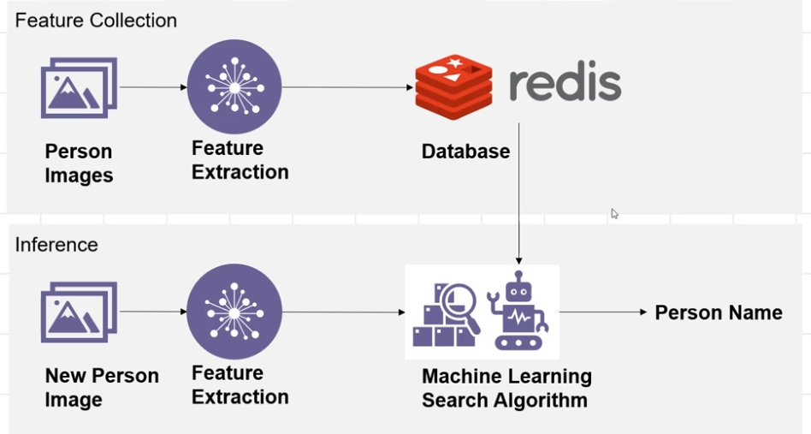
Face Recognition Model
6

Slide 7
How Face Recognition Can Help
Eliminates Buddy Punching
One of the biggest challenges with traditional attendance management systems is buddy punching, where employees clock in for each other. With face recognition, this problem is eliminated as the system can accurately match the face of the employee with their identity.
Saves Time and Increases Efficiency
Using face recognition for attendance management saves time and increases efficiency as it eliminates the need for manual data entry and reduces errors. Employees can simply walk up to the device and have their attendance recorded automatically.
Improved Security
Face recognition provides improved security as it ensures that only authorized personnel are allowed access to the workplace. It also helps in tracking employee movements and can be integrated with other security systems for enhanced protection.

Slide 8
Key Features of Our System
Accurate and Reliable Attendance Tracking: Our system uses advanced face recognition technology to accurately track attendance, eliminating the need for manual tracking and reducing errors.
Real-Time Monitoring: Our system allows for real-time monitoring of attendance data, providing instant updates and alerts on attendance status.
Customizable Settings: Our system can be customized to suit the specific needs of each organization, including settings for attendance thresholds, notifications, and reporting.
Easy Integration: Our system can be easily integrated with existing HR and payroll systems, simplifying the overall attendance management process.

Slide 9
Case Studies
Case Study 1: Large Corporation
A large corporation with over 5000 employees implemented our face recognition attendance management system and saw a 30% reduction in time spent on manual attendance tracking. The system also helped them identify and address attendance issues in real-time, leading to improved productivity and employee accountability.
Case Study 2: Small Business
A small business with 50 employees was struggling with inaccurate attendance records and time theft. After implementing our face recognition system, they were able to eliminate these issues and saw a 20% increase in employee attendance. This led to improved project timelines and overall business performance.

Slide 10
Implementation and Maintenance
Implementation
Our face recognition based attendance management system can be easily implemented in your organization with minimal disruption to your existing processes. Our team of experts will work with you to understand your specific requirements and customize the system accordingly. We will provide training to your staff to ensure a smooth transition to the new system.
Maintenance
Our system is designed for easy maintenance and can be updated remotely. We provide regular software updates to ensure that the system is running smoothly and efficiently. Our customer support team is available 24/7 to assist you with any issues or queries you may have.

Slide 11
Conclusion
A face recognition attendance system can be:
Time-efficient, Accurate, Cost-effective, Efficient, Data secure, Automated, Simple and easy.
Here are some benefits of face recognition attendance systems:
Entry and exit tracking
Employee time tracking
Real-time attendance tracking
Modernization of attendance handling
Time management
Face recognition attendance systems use advanced algorithms to locate and identify faces without human intervention or physical validation. They use data on the characteristics of the human face to identify people.
11

Slide 12

Thank You

